Slide 1
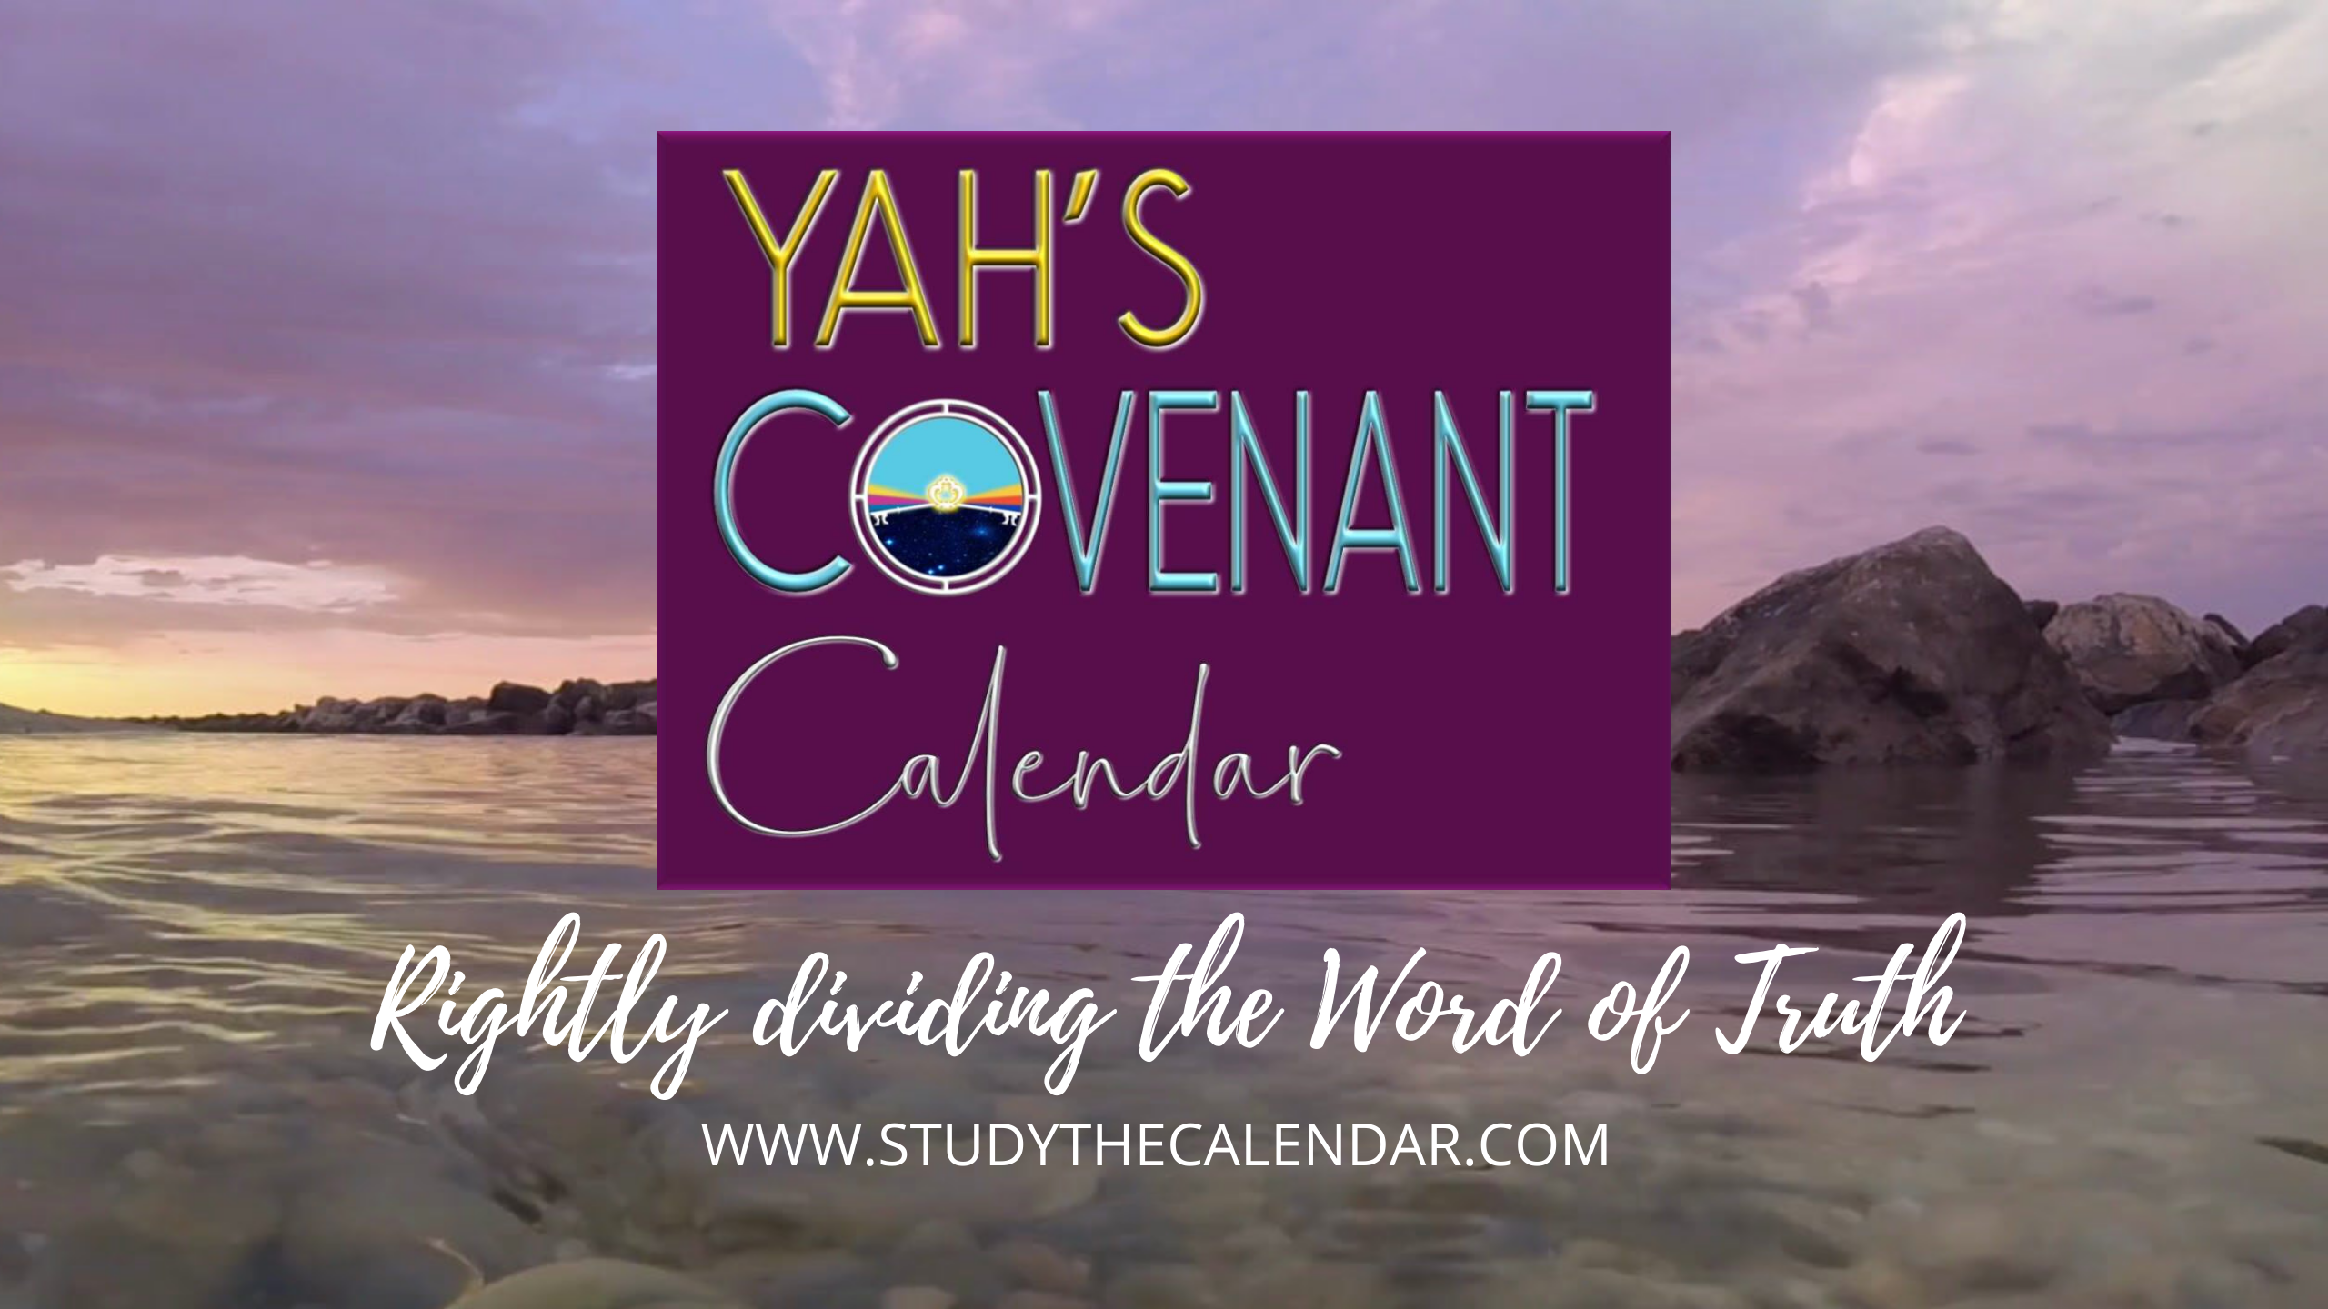
The Moon! Oh, the Moon! Pt 10

Slide 2

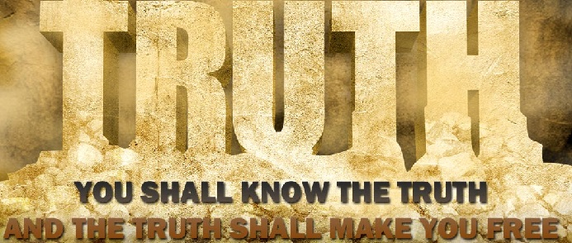

Everyone Wants to KNOW the
The Moon! Oh, the Moon! ~ Pt 10
“My People Have Forsaken Me for the Moon!”
Question for today: How can we know for sure
which ‘no god’ takes priority with Yahuah’s people?
2

Slide 3
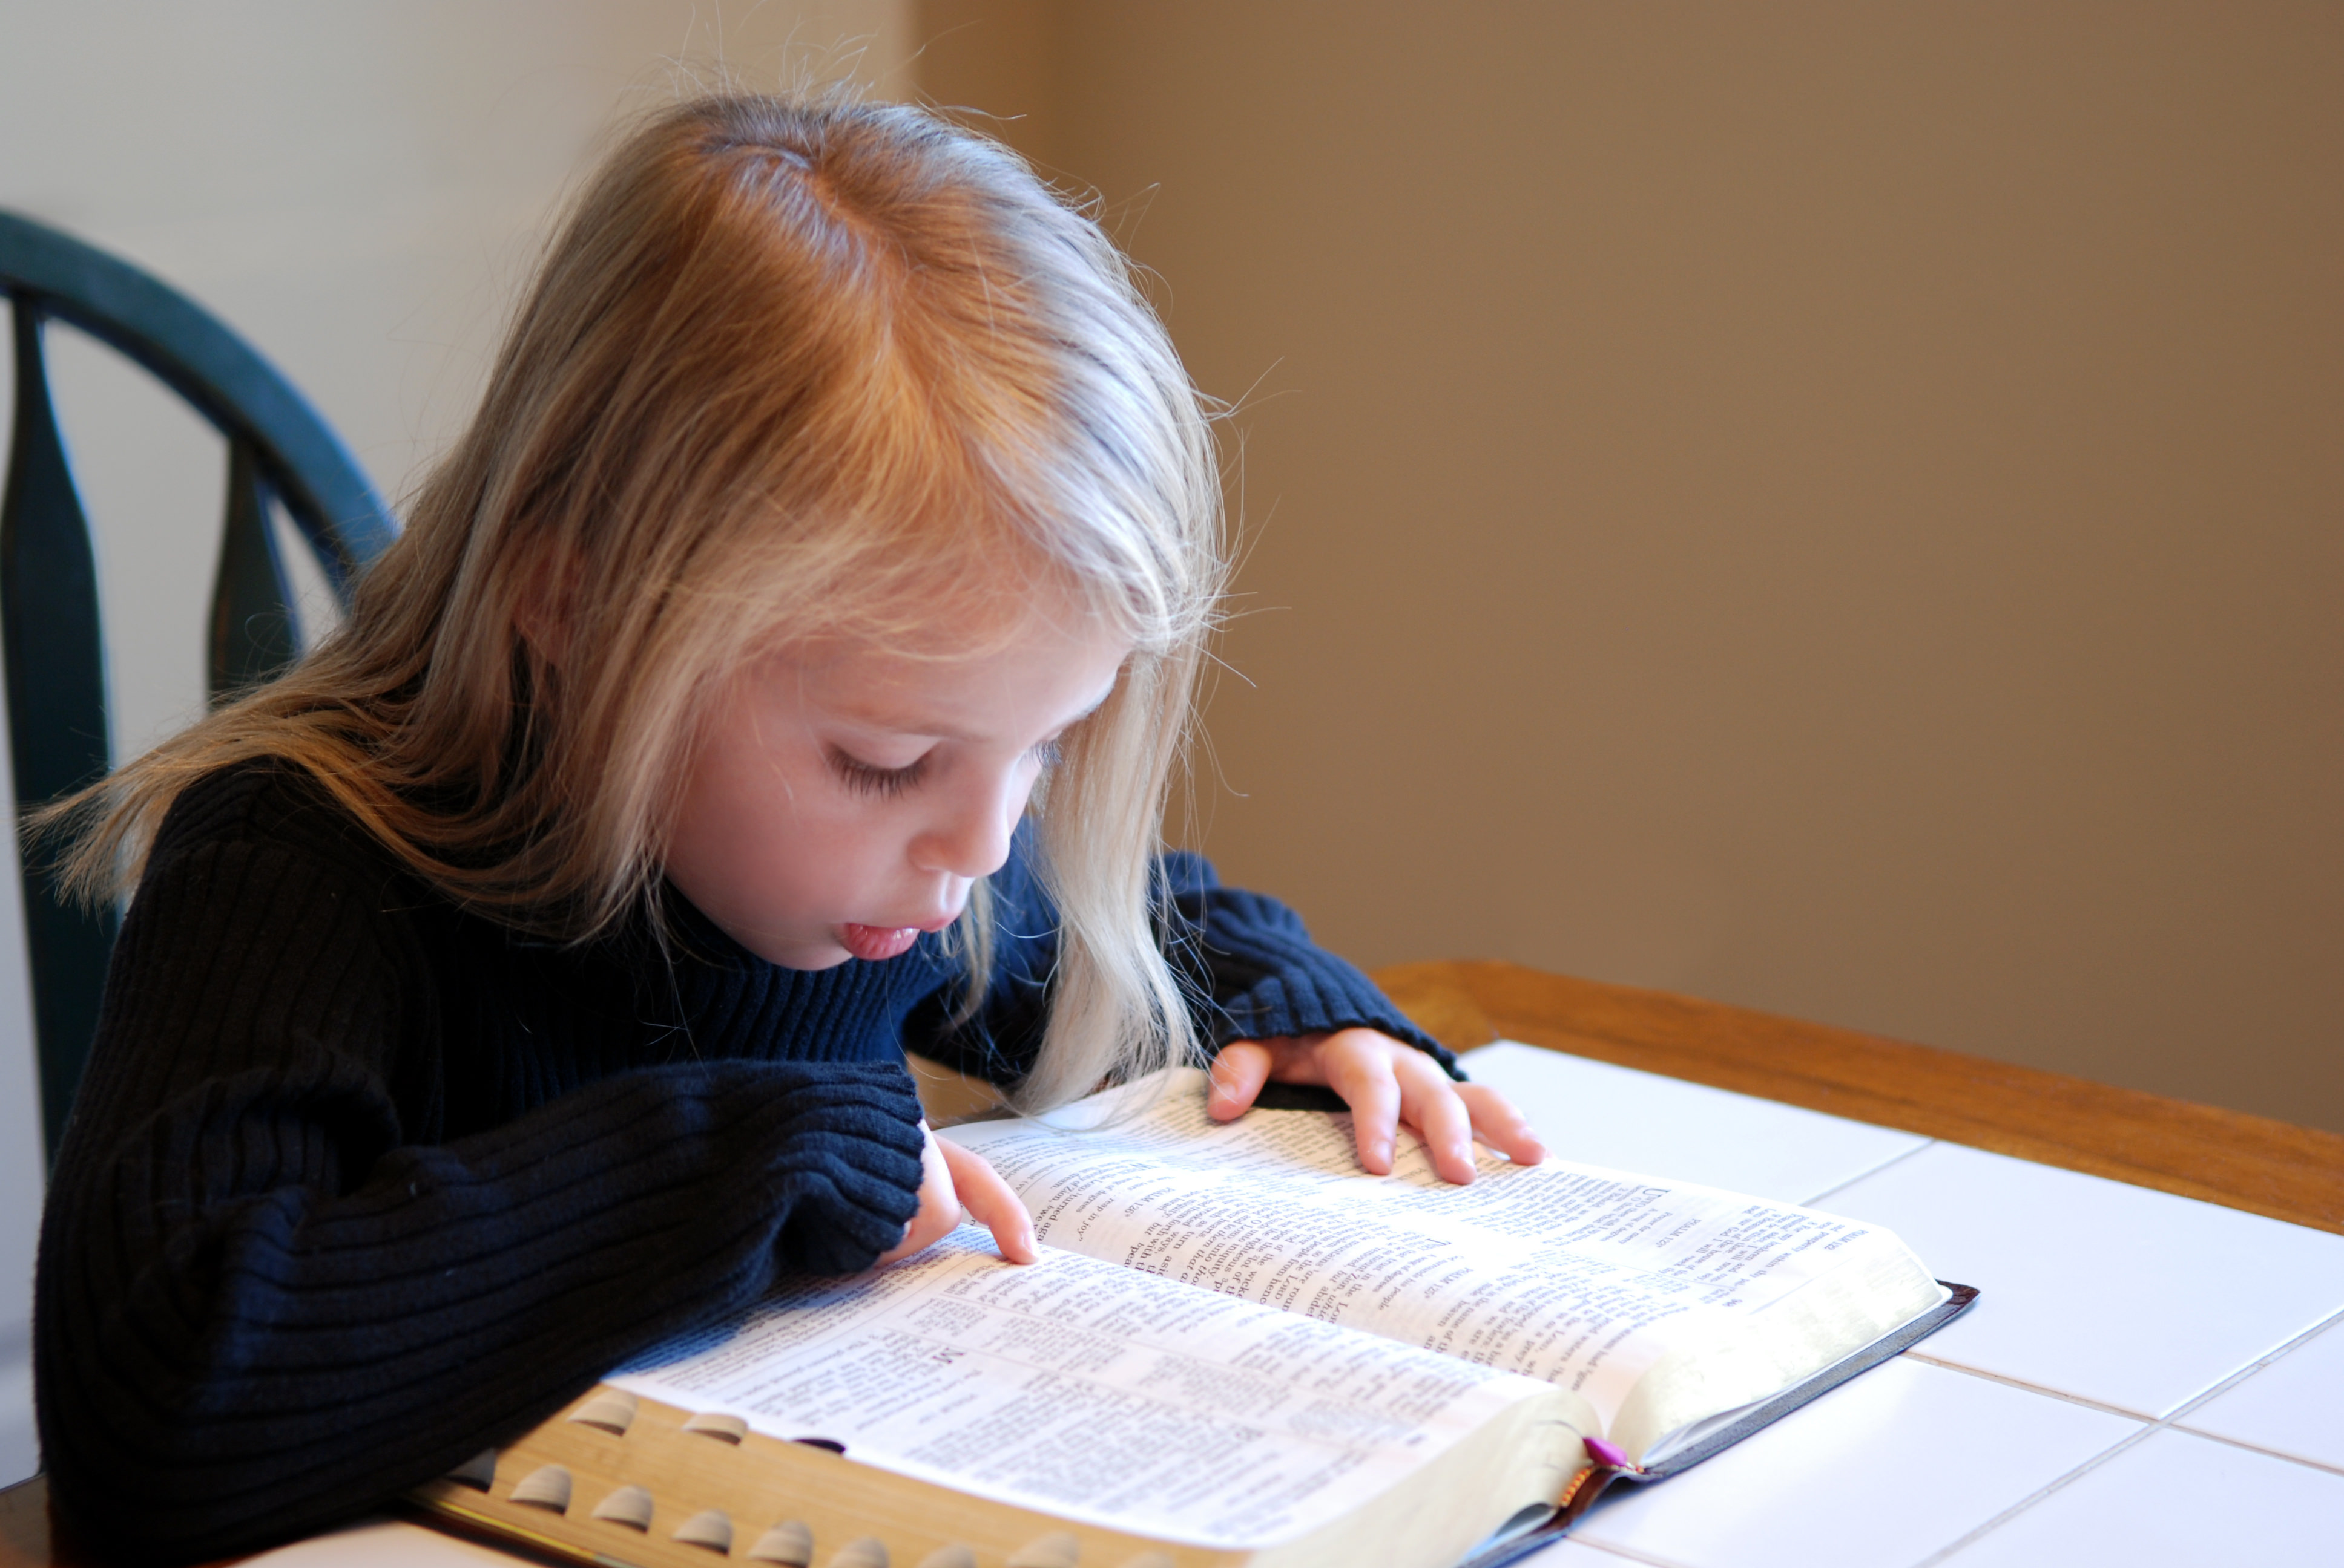
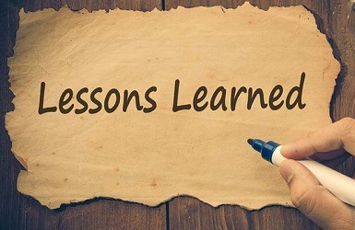
What are the
so far?

Slide 4
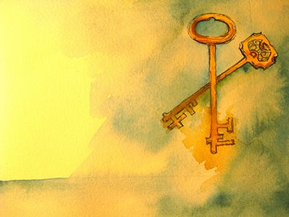


Judah!
… was the entity responsible for removing Yahuah’s Covenant Calendar keys when she should have been paying attention to her job description of teaching
ALL of the laws, instead of changing many of them!
4

Slide 5
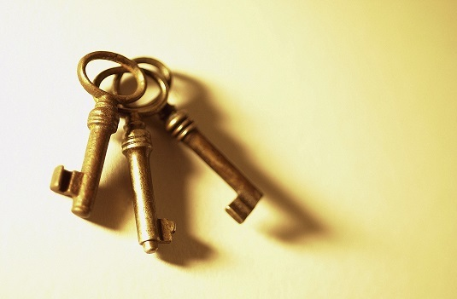
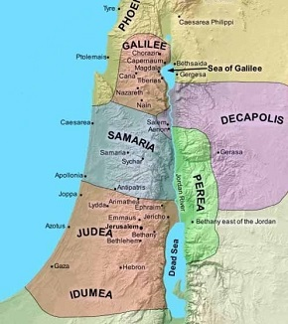
Galilee!
… had the “Light” for calendar!

Slide 6

hey, mr. graduate, now that we know Judah is the most responsible for removing the calendar keys, are we going to find out which ‘no god’ had the most sway over them?
yes, we will find the evidence from the Scripture records! maybe that will be a surprise, or maybe some have figured
it out already.
today we have a
variety of areas to investigate & many more questions to ponder!
never forget,
the Scriptures must
provide the answers
to every question!
we’ll begin with our usual review, then ponder some thoughts before the
rest of the study.

Slide 7
Mapping the Topics for H2320 <chodesh>
R
E
V
I
E
W
1. H2320 Definition
H2320 <chodesh> must come into alignment with Moses & Torah as Yahuah’s “new [chodesh] month”
not Yahuah’s “new moon” or man’s agenda.
(Moon Part #5)
2. Lexicon Challenges
Examination of Theologian’s Hebrew Lexicon Study Tools: 1) Strong’s; 2) Brown-Driver-Briggs; 3) Gesenius;
4) Theological Wordbook of the Old Testament (TWOT).
(Moon Part #5)
From 1450 BC [2550 years after creation]: The Torah Calendar Instructions were for all Kings, Prophets and Leaders, up to and including Yahuah’s people today.
R
E
V
I
E
W
3. Counsel from Moses
(Moon Part #6)
4. New Moon Verses
All 20 “new moon” verses are NON-Torah references mis-translating <chodesh [H2320]> as “moon” instead of “month.” Not one verse aligned with Torah instructions!
(Moon Part #6)
7

Slide 8
Mapping the Topics for H2320 <chodesh>
Investigation of 1611 KJV Translators and their treatment of H2320 <chodesh> in Isaiah 47:13.
Findings: their mis-translation was deliberate!
R
E
V
I
E
W
5. 1611 KJV Translators
(Moon Part #7)
6. Bible Translations
Examination of 10 different translations that clearly give a much better interpretation for
the context of Isaiah 47:13 than the KJV did.
(Moon Part #7)
Examination of 3 Bible Commentators for their insight into the proper meaning and history of
Isaiah 47:13. They agree with proper context.
R
E
V
I
E
W
7. Bible Commentators
(Moon Part #7)
Mapping the Topics for Tanach History
The Old Testament history search began with Adam to Noah to see if any patriarchs were involved & trapped in the worship of ‘no gods.’
8. Adam to Noah
(Moon Part #8)
8

Slide 9
Tanach is spelled right! Sometimes as Tanakh.
Mapping the Topics for Tanach History
9. Flood to Nimrod
Nimrod was worshipped as a ‘no god.’ This happened only after he had died. Semiramis was worshipped as a goddess while yet alive.
(Moon Part #8)
R
E
V
I
E
W
10. Terah & ‘no gods’
Terah and his family lived in the area of Babylon called Ur of the Chaldees where ‘no gods’ were worshipped. Terah manufactured moon idols.
(Moon Part #8)
11. Egypt & ‘no gods’
Egypt also worshipped many ‘no gods’ while Yahuah’s people were in bondage there. Mount Sinai was located in moon worship territory.
(Moon Part #8)
12. Joshua & ‘no gods’
Joshua trained under Moses, the last Melchizedek priest. His mandate was to clear the land of idols. He pleaded with the people to follow Yahuah.
(Moon Part #8)
9

Slide 10
Mapping the Topics for Tanach History
13. Two main ‘no gods’
There are 1000s of ‘no gods’ worshipped in this world today. The two main ‘no gods’ that contend for divine worship are the sun & moon.
(Moon Part #8)
R
E
V
I
E
W
14. Groves & a Garden
The “groves and trees” were specifically designed for the worship of the moon goddess. The worship of a ‘no god’ began with a tree in the Garden of Eden!
(Moon Part #8)
15. Judges to 700 BC
From the heels of Joshua’s excellent leadership, Judges (and up to 700 BC) documents the seriousness of the worship of ‘no gods’ … using pagan calendars.
(Moon Part #8)
16. Part #8 Conclusion
This study is best conducted by placing everything in order of date to see the picture of exactly what is happening. Biblical patterns will be evident.
(Moon Part #8)
10

Slide 11
Mapping the Topics for Tanach History
17. Judah Information (1)
A short section with some general foundational information on the brother Judah and the tribe of Judah with connections to Benjamin and Simeon.
(Moon Part #9)
R
E
V
I
E
W
18. Sundial Introduction
Date: 701-699 BC. Hezekiah was given two signs for a huge turning point in history. Asking for the sun to go back was the right choice?
(Moon Part #9)
19. Historical Records
Velikovsky & Wong document calendar history of 30 ancient civilizations around 700 BC when the year length changed from 360 days/year.
(Moon Part #9)
20. Hezekiah - Nehemiah
700-400 BC: The sundial miracle was Yahuah’s deliberate attempt to move His people back to His ways of worship. Nehemiah - last great reformer.
(Moon Part #9)
11

Slide 12
Mapping the Topics for Tanach History
21. Judah Information (2)
New Testament Era: A short section with some general foundational information on the tribe of Judah, Judas [Judah] the Betrayer and non-Jews.
(Moon Part #9)
R
E
V
I
E
W
22. Naphtali & Galilee
A short investigation between Naphtali & Galilee in relation to Judea. Judah is NOT the Lawgiver! From Galilee Yahuah taught His calendar truth.
(Moon Part #9)
23. Jerusalem & Pella
From the cross to 70 AD and up to 100 years+ later, Paul and the apostles [Nazoreans] honoured all of Covenant Torah including the Calendar.
(Moon Part #9)
24. Audience Participation
Time to ponder thoughts on how the Covenant Calendar keys were lost and by whom … the OT history clarified where the troubles originated.
(Moon Part #9)
12

Slide 13
Mapping the Topics for Lunar Conclusion
25. Egyptian History
Egypt’s history is interesting, as they had some things right. Remember, Joseph was next to Pharaoh many years & Moses gain much knowledge while there.
NEW
L
E
S
SON
(Moon Part #10)
26. Babylonian History
This will include a short examination of history from Babylon as compared to what was happening within the Jewish culture & economy.
(Moon Part #10)
27. Jewish History
What festival is attached to the new moon? What calendar did the Jews adopt? How was that calendar refined? What key was removed?
(Moon Part #10)
28. Let’s Talk Talmud
Talmud historical quotes and mis-quotes will
be compared to Moses and Torah with regards
to alignment with Yahuah’s Covenant Calendar.
(Moon Part #10)
13

Slide 14
Mapping the Topics for Lunar Conclusion
29. Bible Dictionaries
Man’s commentaries, lexicons and dictionaries can be helpful study tools. What will these commentaries have to say about the moon?
NEW
L
E
S
SON
(Moon Part #10)
30. Moon in Question
It’s time to ask some questions based on all the previous research and logic.
(Moon Part #10)
31. Review OT Moon
A quick review of Moon Studies #8 & #9 before we face the re-appearing question of the roots of paganized Christianity today.
(Moon Part #10)
32. Paganized Christians
Yahuah longs for Christian churches to be in covenant with Him. Today, what ‘no gods’ are most denominations [nearly 40,000] attached too?
(Moon Part #10)
14

Slide 15
Mapping the Topics for Lunar Conclusion
33. Priority ‘no god’
Out of the 2 main ‘no gods’ found in Scripture,
a simple comparison will be made from the
Old Testament evidence of which takes priority.
NEW
L
E
S
SON
(Moon Part #10)
34. Audience Participation
1) Where are the ‘no gods’ hidden in most feast calendars today? 2) What are your thoughts on the ‘no god’ that takes priority in the OT & today?
(Moon Part #10)
35. “Thine Accusers”
It is time to reflect on all the information that has been gathered and consider how “thine accusers” shall be answered in the future?
(Moon Part #10)
36. What’s Next?
The door to the moon study may never be closed, however the upcoming presentations will again touch on the calendar “commencement” issue.
(Conclusion for #10)
15

Slide 16

Points to Ponder &
Questions of Wonder
Sun & moon worship received a solid foothold with Nimrod
and Semiramis after the flood.
Between Adam to Noah there is no Scriptural record
against the patriarchs for worshipping the sun or moon gods.
Of all the pagan gods, the sun god and moon goddess
represent the major “no gods” in sacred history.
If the sun god and moon goddess are the dominant pagan gods,
which one of the two takes the #1 position?
If sacred regard, and/or allegiance of any kind, is given to
the sun and moon for any reason, is this classed as worship?
If the sighting of the sun and moon are part of the
worship calendar, is that action regarded as worship?
Will the Covenant Calendar study be able to conclude which is
more deceptive: the worship of the sun god, or the moon goddess?

Slide 17

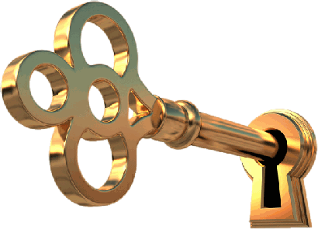



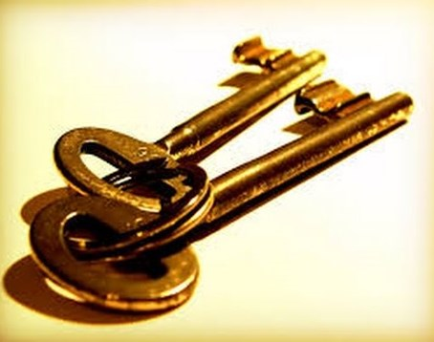
Now that we know
exactly who is really responsible for removing
the Covenant Calendar keys,
we are ready to address the next important question …

Slide 18

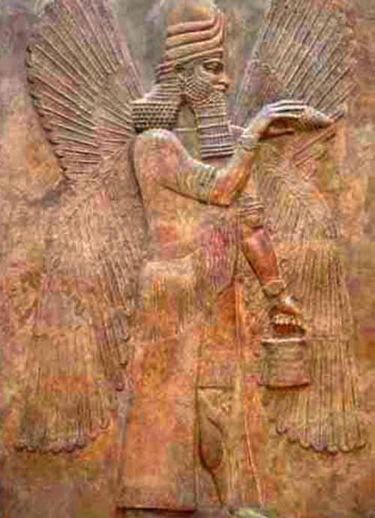
Which “no god” will gain the authority of the calendar?
… the sun god?
Notes:
Sept 14

Slide 19
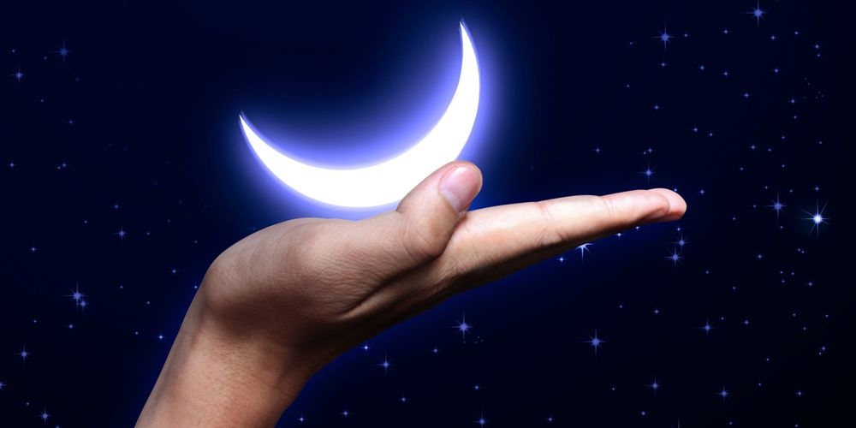
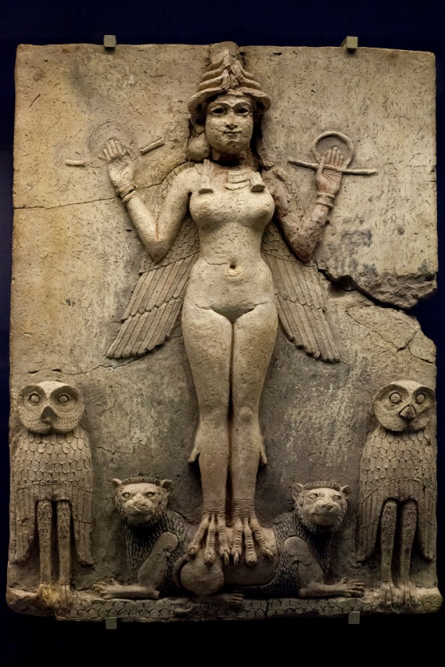
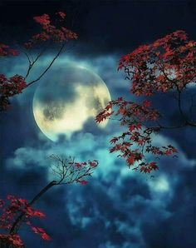
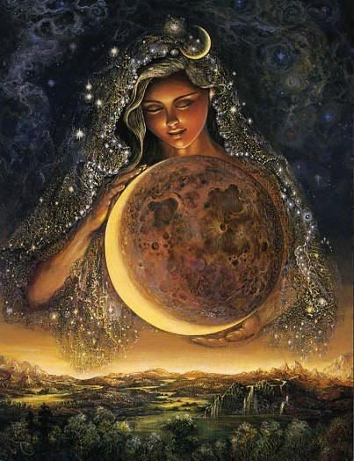

… or the moon goddess?
Shall we expose the answer right up front so everyone
can follow the problem?
Semiramis
Moon
Goddess
Notes:
Sept 14-p3+

Slide 20
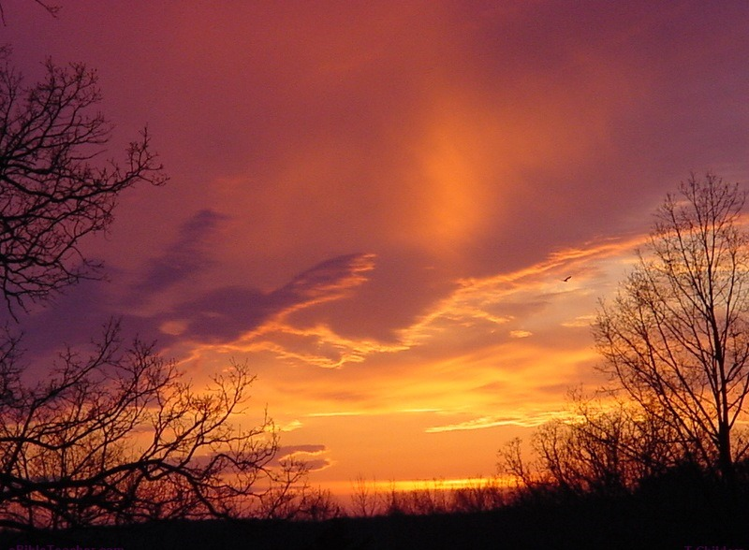
As the Old Testament closes on the last 1500 years of history for Israel and Judah - it is a sad commentary to find them
very unrepentant, continuing even faster on their path of abomination, adopting the worship practices of the pagans.
This historical piece of history is a pattern of what not to do, and of where not to go.
As Yahuah’s calendar is being restored, He can/will be worshipped on His terms, not pagan terms.
The next piece of this investigation will be a very specific study on some secular historical information of the moon. Can the moon command (or deserve) any sacred regard.
Will the study reveal if we are dealing with a:
Lunar Deception (and/or a)
Lunatic Authority?
Notes:
Sept 19

Slide 21
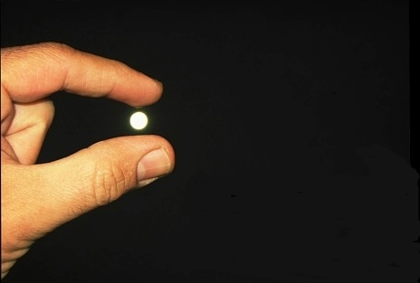
Yes, we will be exposing more on the moon in this study especially through …
Egyptian & Babylonian history
Talmud information
Bible Dictionaries and Commentators
Notes:
Sept 13

Slide 22
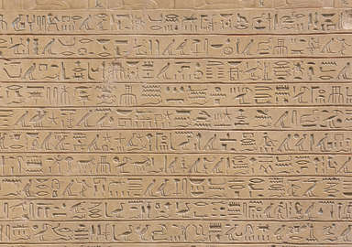
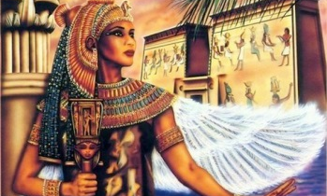
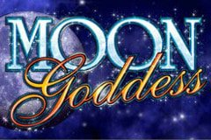
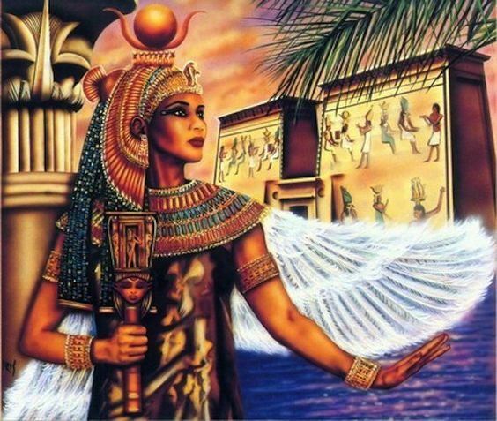
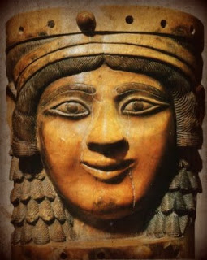
Egyptian & Babylon History of Moon Worship
Ever Wonder about the Roots of Moon Worship?
No wonder Yahweh said not to give “sacred regard” to the moon!

Slide 23
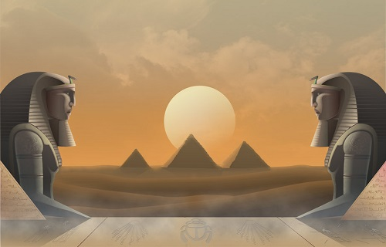
Egyptian Calendar History
About the 7th century (BC) Egypt’s 360 day calendar (that was in use for 1000’s years)
was challenged by the sundial event.
Priests were assigned the duty of sighting
the new moon for month start, a practice also observed by Babylon and the Hebrews.
Egypt had already mastered the art of constructing pyramids to accurately
track the yearly equinox.
(~1500 BC)
Acts 7:22 Moses was learned in all the wisdom of the Egyptians.
Notes:
268cf … july 2/17 … fixed the artwork

Slide 24
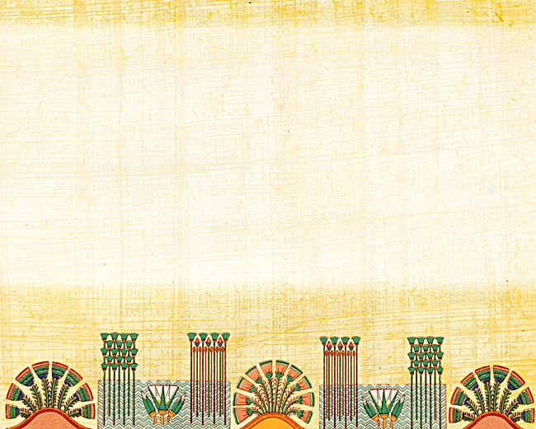
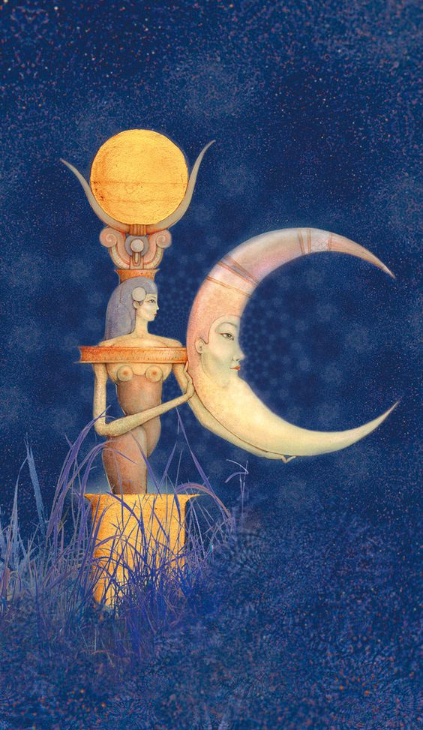
Egyptian Day & Month Start
Egyptians began each new day with sunrise.
Their new month began with the disappearance
of the old moon just before dawn. (Note: the Mul-Apin tablets prove they were on a firm 30 day month.)
Their civil calendar was 360 days with an additional
5 days grouped together at the end of the year.
The lunar calendar followed the moon cycles to
regulate their religious affairs.
The lunar calendar {through humanly designed manipulation} also corresponded with the seasons.
Sun
Moon
Egyptian Moon
Goddess:
Isis
Notes:
268cf … july 2/17 … fixed the artwork

Slide 25
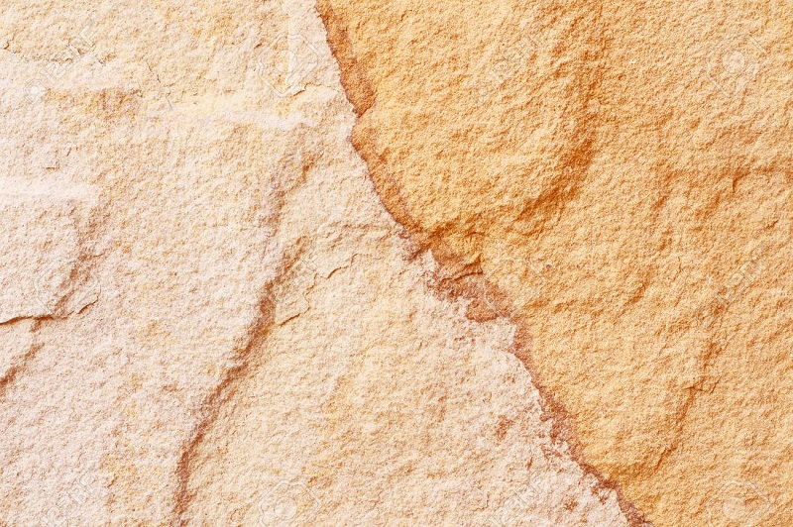
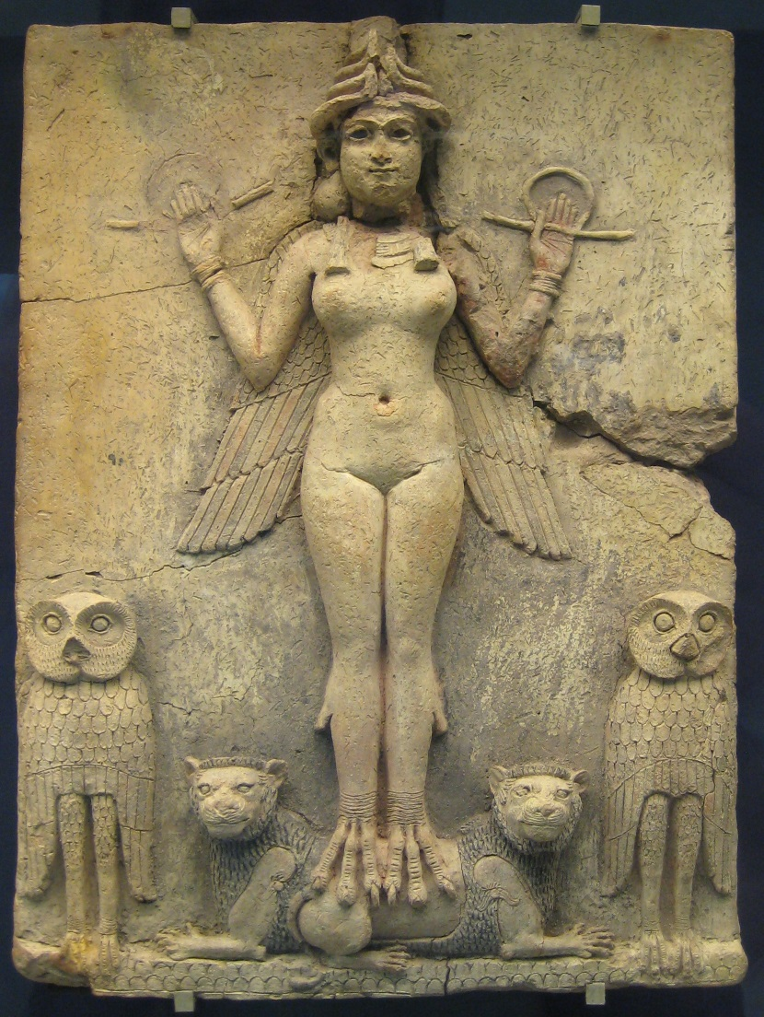
Babylonian Calendar History
About 2300 BC, Sumerians had a calendar that divided the year into 30-day months [360 days/year].
The months began at the first visibility of the new moon. [Remember Isa 47:13.]
In time, they designed a calendar fitting
the luni-solar cycle over 19 years, with
7 yearly intercalations of a 13th month
[as the “Jews” have adopted to this day].
The months were truly lunar.
The “new moon day” began at sunset when the new moon was first visible.
The
Babylonian Moon
Goddess:
Ishtar
Notes:
269cf … july 2/17 … fixed the art work

Slide 26
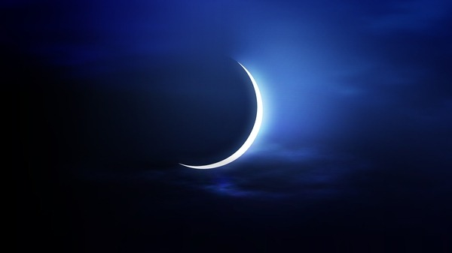

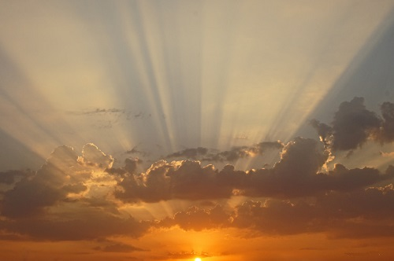
Jewish History of
Moon Worship
1ST day of the 7TH Month
Is the above picture a familiar sighting?
Many watch for the crescent moon to
establish the 1st day of the 7th month
as the Feast of Trumpets.
Notes:
271cf … july 2/17

Slide 27

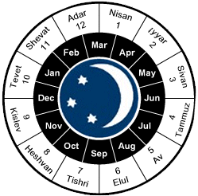
Jewish Calendar History
Tim, from the internet … What was the ziggurat of Ur used for?
Moon Goddess Nanna. The Ziggurat at Ur and the temple on its top were built around 2100 B.C.E. by the king Ur-Nammu of the Third Dynasty of Ur for the moon god Nanna, the divine patron of the city state.
-- Are there ziggurats in Egypt?
Ziggurats are pyramidal in shape, but not nearly as symmetrical, precise, or architecturally pleasing as Egyptian pyramids. ... There are fascinating parallels between the ziggurats of Mesopotamia and the temples of Mayan culture in Central America.
-- Why was the ziggurat important?
The main reason ancient Mesopotamians built ziggurats has its roots in religious beliefs. They built them to make the temples closer to the heavens and therefore closer to the Gods. This is tied to the belief that Gods appeared on earth at the highest point in the land.
Tim … this quote from the web talks about the jews using a greek calendar for a while, but does not say what was different about it. This is a huge amount of research, so I have taken the comment off the slide about the greek calendar. If interested, read the following:
After the conquest of Jerusalem (587 bce), the Babylonians introduced their cyclic calendar (see above Babylonian calendars) and the reckoning of their regnal years from Nisanu 1, about the spring equinox. The Jews now had a finite calendar year with a New Year’s Day, and they adopted the Babylonian month names, which they continue to use. From 587 bce until 70 ce, the Jewish civil year was Babylonian, except for the period of Alexander the Great and the Ptolemies (332–200 bce), when the Macedonian calendar was used. The situation after the destruction of the Temple in Jerusalem in 70 ce remains unclear. It is not known whether the Romans introduced their Julian calendar or the calendar that the Jews of Palestine used after 70 ce for their business transactions. There is no calendar reference in the New Testament; the contemporary Aramaic documents from Judaea are rare and prove only that the Jews dated events according to the years of the Roman emperors. The abundant data in the Talmudic sources concern only the religious calendar.
From: https://www.britannica.com/science/calendar/Ancient-and-religious-calendar-systems
Prior to Hezekiah the keeping of the lunar calendar was simple as each lunar month had 30 days for 12 months – matching the solar yearly timing.
From 587 BC - 70 AD the Jewish civil year was Babylonian adding
in a 13th intercalated month, – a system straight from Babylon.
Later, Meton (the Greek, about 432 BC), detailed and refined the
Metonic cycle, also accepted by the Jews.
The commencement of the month was always determined
by the observation of the crescent new moon.
After Nehemiah & Malachi, many feel the Jews were no longer worshipping the sun & moon gods outright.
What did they do with these pagan gods?
Notes:
272cf … july 2/17

Slide 28
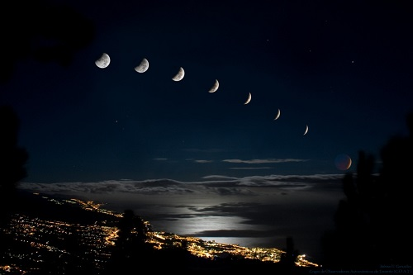
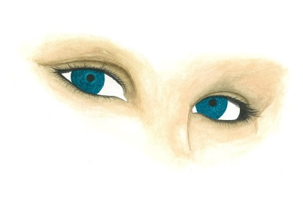
Jewish Calendar is Luni-solar
By 200 AD visual observation of the moon was
supplanted by secret astronomical calculation.
Much was determined according to the Talmud.
The Luni-solar calendar (and its Metonic cycle) forms
the basis for the computation of the date of Passover
each year in combination with Hillel’s calendar of 359 AD.
Remember (under Constantine): As the Roman religious persecutions
continued, Hillel decided to provide an authorized calendar for all time
to come, though by doing so he severed the ties which united the Jews
of the diaspora to their mother country and to the patriarchate.
Jews were then able to calculate the calendar and festival times themselves.
patriarchate
pa·​tri·​arch·​ate | \ˈpā-trē-ˌär-kət,
-ˌkāt\
The Jews could no longer find their Calendar between Gen 1:1 - Exo 24:11.
Notes:
273cf … july 2/17

Slide 29
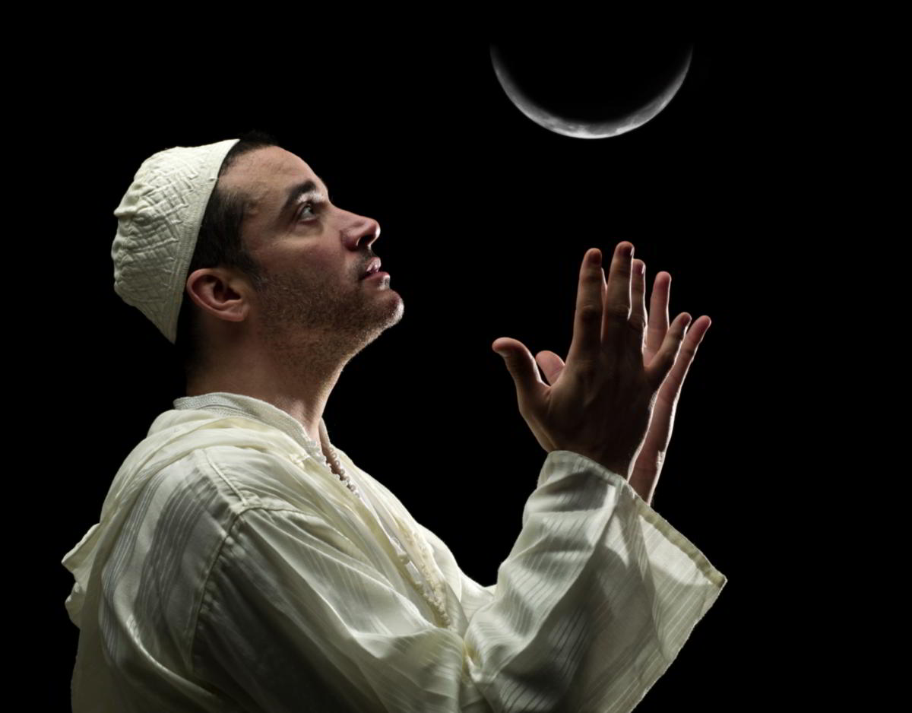




The Effects of a Luni-solar Calendar
When the Jews opted out
of allegiance to the Tequfah, another MAJOR EFFECT redesigned their calendar!
The calendar was re-designed by giving it a lunar format. By default of a lunar format, the recipient of this worship
from man was automatically
re-designated from
Yahuah to Satan.
Another
‘key’ lost?
Notes:
273cf … july 2/17

Slide 30
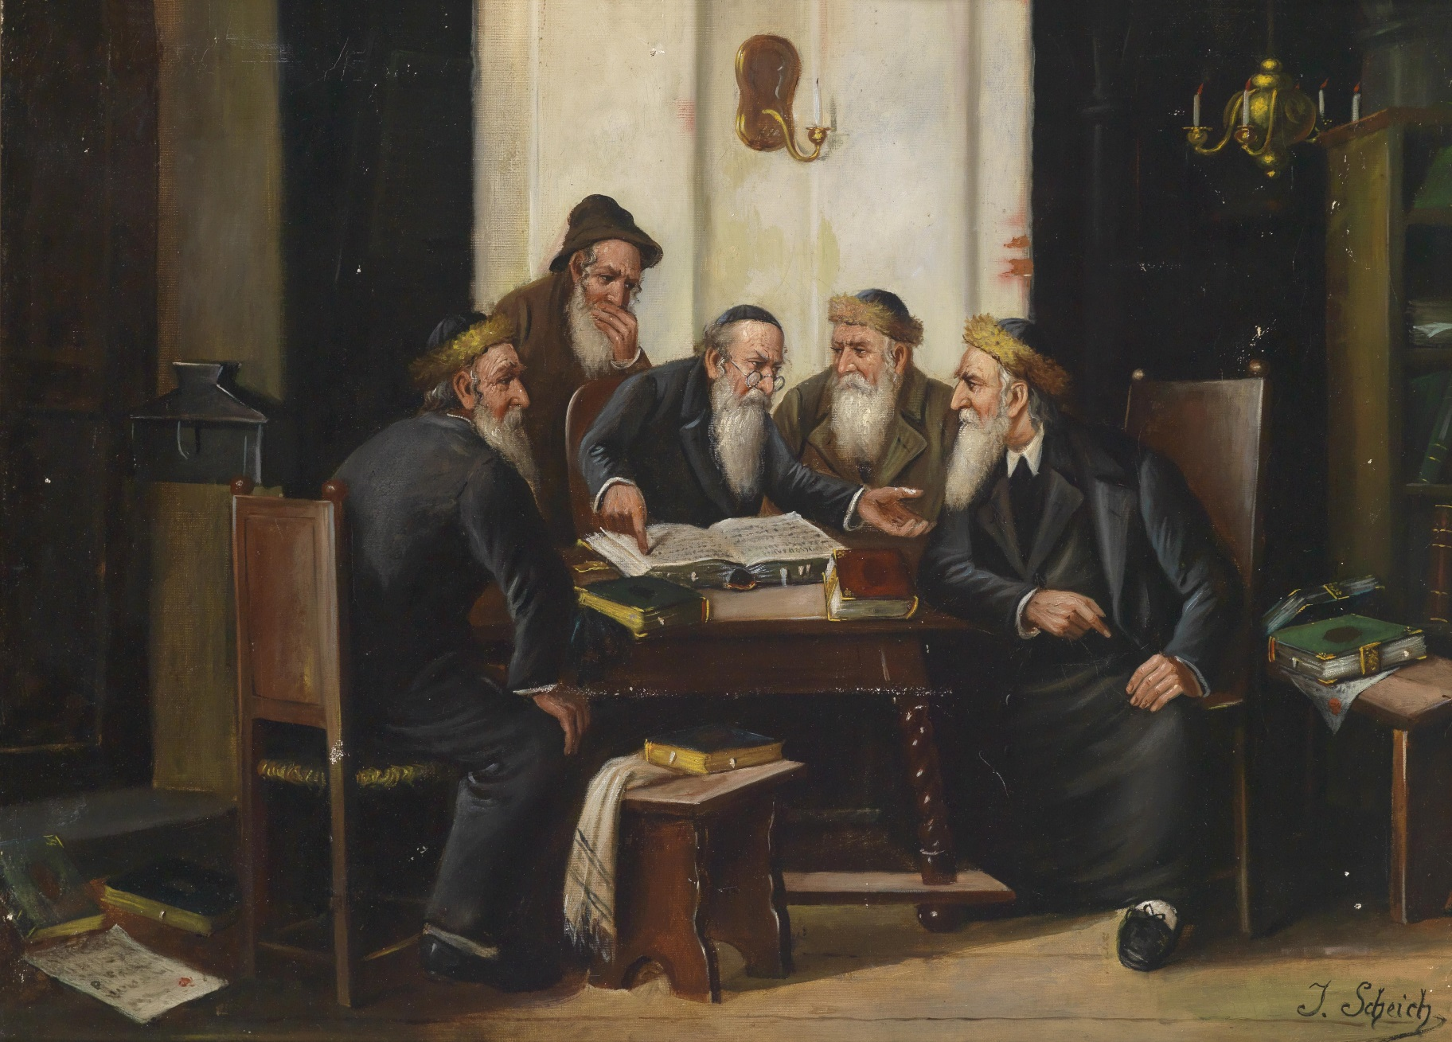
Who Muddled With the Divine Calendar?
Judah!
Answer: The ones who were to preserve it!
Notes:
274cf … july 3/17

Slide 31
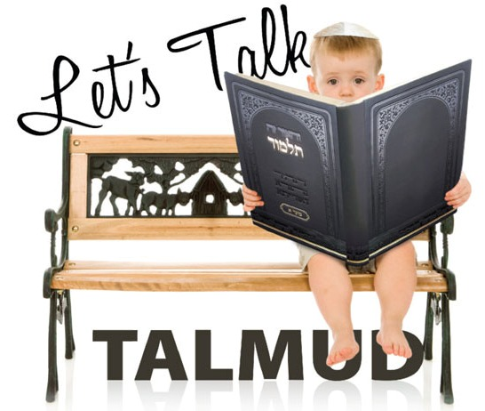
Who’s Responsible For Upholding the Moon?
The Talmud
Has NO
Authority
Over “the”
Scriptures!
Upon reading the following quotes from the Rabbis under the given website, do take notice that starting the month with the sighting of the moon has NO Scriptural authority.
Notes:
276cf … july 3/17 … all the slides for the talmud quote were missing … I think you simply did miss them, or intended to place them in later. I’m going to go ahead and add them in, and if you don’t want all 9 slides, then select the best and toss the rest, or move them to the end of the PPT for later on.

Slide 32

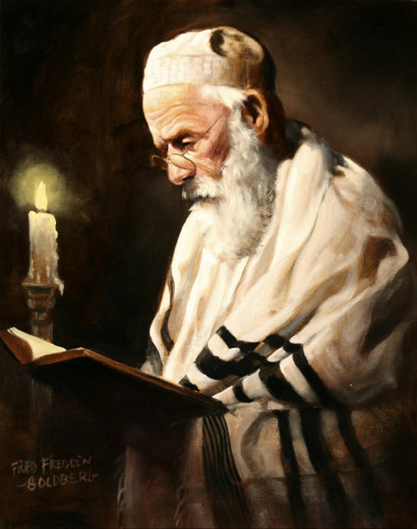
We have ‘Zero’ Scriptural Permission
Consider this website quote: https://en.wikibooks.org/wiki/Hebrew_Roots/New_Moon
“There is zero scriptural evidence for sighting new moons to determine the beginning of new months.
It is based 100% on teachings within the Talmud.”
Notes:
275cf … july 3/17 … changed background for variety

Slide 33

1) Quotes for Month Commencement
“[T]he new moon began when the thin crescent of the new moon was first visible at sunset.”
(Theological Wordbook of the Old Testament, vol. 1, p. 266.)
“The ancient [pagan] Greeks recognized the visible new moon as the beginning of the month when they celebrated the “sickle of the new moon” with offerings and meals.
This was also the case with the ancient Babylonians who worshipped the new moon as the goddess Isis, and had her wearing horns, which resembled the new moon.”
(Theological Dictionary of the New Testament, vol. 4, p. 639.)
Notes:
277cf july 3/17

Slide 34

2) Quotes for Month Commencement
“[T]he ancient Jewish calendar depended not on mathematical calculations and arrangements, but
was set from month to month according to the
physical appearance of the new moon.”
(The Pharisees, by Louis Finkelstein, p. 601, Jewish Publication Society, 1938, Philadelphia;
based on Talmudic literature.)
“In old Israel the new moon - the day after the crescent was first sighted in the sky - was celebrated by sacrifices and feasting …”
(Judaism, by George Foot Moore, professor of the history of religion, Harvard, vol. 2, p. 22,
based on Talmudic literature.)
Notes:
278cf … july 3/17

Slide 35

3) Quotes for Month Commencement
“Rosh Chodesh [is the] Hebrew term meaning ‘the beginning of a month’ applied to the religious half-holiday observed in connection with the appearance of the New Moon; that is, the beginning of each new month of the [Jewish] Hebrew calendar.”
(The New Jewish Encyclopedia, p. 409, Behrman House Publishers, 1976, based on Talmudic literature.)
“Philo, the Jewish historian and contemporary of Yeshua the Messiah and the apostles, says that Moses established the moon of the vernal equinox as the first month of the year.
(The Works of Philo, On the Life of Moses II, chapter XLI, Part 222 and 224.)
Josephus the Jewish historian also confirms this and defines
it as ‘when the sun was in Aries.’ ”
(Josephus, Ant. 3.201; III.x.5.)
(Question: Where is the Scripture
for these claims in the Torah?)
?
All of this is Jewish Contamination/Abomination
in the purest form!
Notes:
279cf … july 3/17

Slide 36
4) Specific Quotes From Talmud
“In the times of the Second Temple it appears from the Mishnah (R. H. i. 7) that the priests had a court to which witnesses came and reported. This function was afterward taken over by the civil court (see B. Zuckermann, “Materialien zur Entwicklung der Altjüdischen Zeitrechnung im Talmud, “Breslau, 1882).
The fixing of the lengths of the months and the intercalation of months was the prerogative of the Sanhedrin, at whose head there was a patriarch … The entire Sanhedrin was not called upon to act in this matter, the decision being left to a special court of three. The Sanhedrin met on the 29th of each month to await the report of the witnesses.” (continued)
Notes:
280cf … july 3/17

Slide 37

5) Jewish Quotes (con’t)
[continuing point #7]
“On the evening before the announcement of the intercalation the patriarch assembled certain scholars who assisted in the decision.
It was then announced to the various Jewish communities by letters.
To this epistle was added the reason for the intercalation. A copy of such a letter of Rabban Gamaliel is preserved in the Talmud (Sanh. xi. 2).”
“In the Mishnah, the book containing the late second century record of Jewish legal rulings and other religious records, we find recorded that the Jews’ religious leaders established rigorous protocols and
rituals for determining when the new moon had been sighted.”
(Question again: Where is the Scripture for these claims in the Torah?)

Slide 38
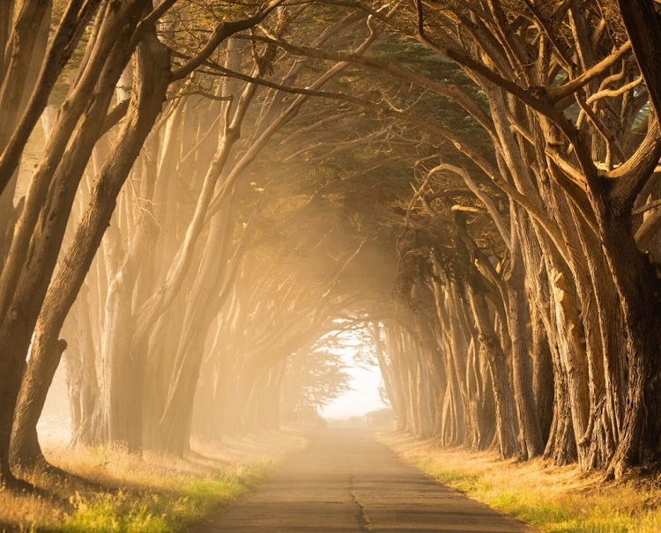
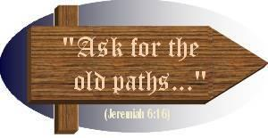
It’s Time to Remember …
Jer 6:16
Jer 6:16 counselled the people to
Thus saith Yahuah, Stand ye in the ways, and see,
and ask for the old paths, where is the good way,
and walk therein, and ye shall find rest for your souls.
Also remember … David would have written
Ps 81:3-4 according to Moses & Torah.

Slide 39
6) Quotes Regarding Joseph & Ps 81:3
“Psalm 81 tells us that Joseph instituted the Rosh Chodesh during his tenure as the viceroy of Egypt. Joseph had the power to declare the decree and the people of Egypt, principally the sons of Israel, were delighted to make the recognition of the new moon as a joyful feast. The testimony was to honor Joseph for what he did as a righteous deliverer, who in many ways prefigured the coming Messiah of Israel
and the redemption that He would ultimately bring. All of Yahuah's feasts are a role play of eternal truths in His eternal purposes and keep His redemptive plan before us. What Joseph set in place as a testimony,
has been established as a "statute for Israel, a law of the God of Jacob."
(Psalm 81: 3-4)
(The Works of Philo, On the Life of Moses II, chapter XLI, Part 222 and 224.) Josephus the Jewish historian also confirms this and defines it as "when the sun was in Aries" (Josephus, Ant. 3.201; III.x.5].
(Note again: Ps 81:3 has no basis from Torah to blow the trumpet on the new moon!)

Slide 40
7) Quotes Regarding Moses & Num 10:10 (con’t)
“In Numbers 10:10 it is recorded that the trumpet is to be blown to sanctify the new moon as a feast day. “At the beginnings of your months [H2320 chodesh] you shall offer a burnt offering to Yahweh: ... this is the burnt offering of each month throughout the months of the year … it shall be offered besides the continual burnt offering and its drink offering.” (Numbers 28:11-15 RSV) Moses called the people to an
assembly on the new moon and spoke to them according to the commandments he had been given by Yahweh, exhorting them to faith and obedience.”
(Note again: Num 10:10 records “new month” … not … “new moon.”)
Really?

Slide 41




Psalm 81:3 & Num 10:10 Scrutinized
Psa 81:3 Blow up the trumpet in the new moon month [H2320;
renewal of 1st day of Yahuah’s month], in the time appointed [H3677; fullness],
on our solemn feast day [H2282; every festival].
Psa 81:3 must follow the Torah instructions given by Moses.
Num 10:10 Also in the day of your gladness, and in your solemn days, and in the beginnings of your months [H2320; not H3391 lunar month],
ye shall blow with the trumpets …
Between Num 10:10 & Psa 81:3 there is no mention of H3391 [yerach].
H3391 never qualifies any lunar phase to commence Yahuah’s feast months.
R
E
V
I
E
W
Psalm 81 & Numbers 10 do agree the
moon does not begin the month!
The writings of Philo & Josephus
do not align with Torah!

Slide 42

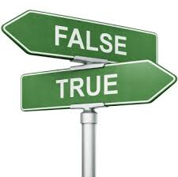
8) Misquotes Stated as Truth (Nehemiah)
“In the restoration of the law under Nehemiah the new moons were re-instituted and kept from that time through to the destruction of the Temple in
70 CE. Josephus records that they were kept during the entire Temple period and the
High Priest attended in the Temple
on the new moons and Sabbaths.”
Tim said: this infusion of falshood is the epitome of subtleness
Tim’s comments about Nehemiah: The only VERY SLIGHT "UNTRUTH" IS THE NAME OF NEHEMIAH! Otherwise the remainder of this quote is true! Yes the lunar system was adhered to! The SUBTLE EVILNESS is the adding of the name Nehemiah! He did not worship the moon! This is the subtle convolution of SATAN!
Nehemiah?
Really?

Slide 43
9) Misquotes Stated as Truth (Solomon)
“Moses commanded the keeping of the new moons. In 2 Chron 8:12-13 Solomon said that it, as well as the other feasts, were "an ordinance forever to Israel."
(2 Chron 2: 3-4)
“As sincere followers of Yahuah's word, we should be observing them [new moons] now and preparing ourselves as His Bride, fully adorned in all righteousness.”
The Bride observing new moons?
Really?
Not Yahusha’s Bride!

Slide 44
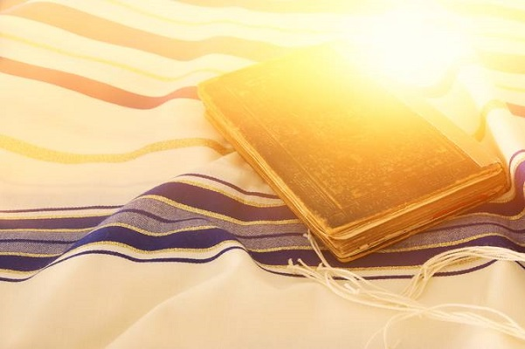

Let’s remember the following:
Just because the Rabbis
can be quoted, and just because the Talmud
has written instruction
on rules following the crescent moon … this is hardly a reason to accept the new moons as the beginning of the month.
Torah has priority!
Crucifixion reveals the fulfilment!
Not the Rabbis or non-Jews of Rev 2:9 & 3:9.

Slide 45
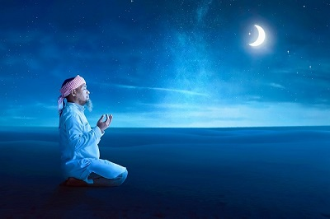
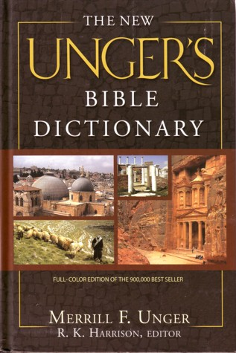
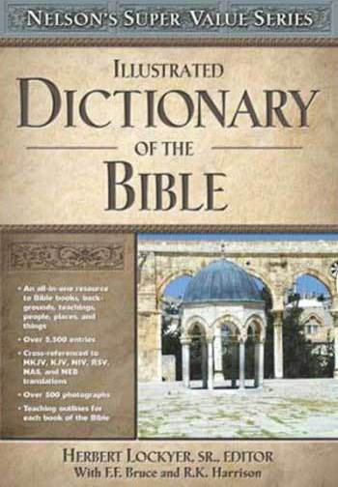

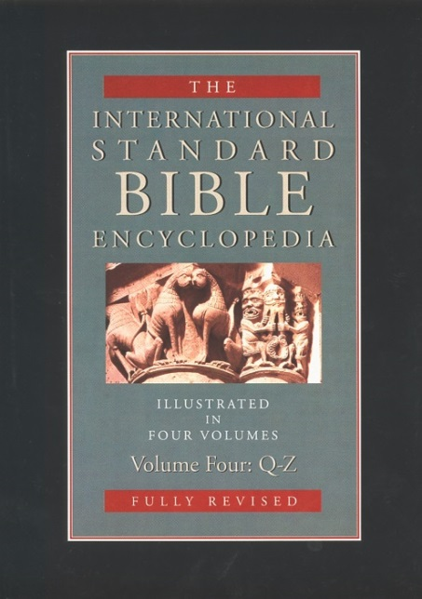
Moon Comments from Bible Dictionaries
Will any of these commentaries agree with Scripture,
or will they support
the
Talmud
and the moon/month teachings?
Many commentaries recognize the fact that Yahuah's people were easily influenced by the pagans that
worshipped the moon. Take careful note of this history!

Slide 46
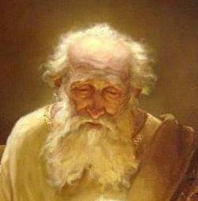
1) New Unger’s Bible Dictionary
The worship of the moon was extensively practiced by the nations of the East. Ur in lower Mesopotamia, Abraham's birthplace, was an important center of the worship of Sin, the moon god, as was Haran in Upper Mesopotamia, where Abram and Terah emigrated. In Egypt the moon was honored under the name Isis and was one of the only two deities that commanded the reverence of all the Egyptians. In Syria the moon was represented by one of the Ashtaroth surnamed "Karnaim," from the horns of the crescent moon by which she was distinguished. There are indications of the early introduction into the countries adjacent to Palestine of a species of worship distinct from any that we have described, namely, the direct homage
of the heavenly bodies-sun, moon, and stars-characteristic of Sabianism.
The first notice we have of this is in: Job 31:26-28 …
26 If I beheld the sun when it shined, or the moon walking in brightness;
27 And my heart hath been secretly enticed [to worship them] …
28 This also were an iniquity to be punished by the judge:
for I should [would] have denied the Elohim that is above.
R
E
V
I
E
W

Slide 47

1) New Unger’s Bible Dictionary (con’t)
… and it is observable that one warning of Moses as found in Deut 4:19 … is directed against this nature worship rather than against the form of moon worship that the Israelites must have witnessed in Egypt.
At a later period, however, the worship of the moon in its grosser form of idol worship was introduced from Syria.
In 2 Kings 23:5 we read that Josiah did away with those “who burned incense to Baal, to the sun and to the moon.”
Except for a brief period under Josiah, Manasseh appears to have been the great patron of this form of idolatry, for he "worshiped all the host of heaven" (21:3, 5). From his reign down to the [Babylonian] captivity,
moon worship continued to prevail among the Jews.
Date?
About 624 BC – 18 years before Babylon arrives.

Slide 48
2) Nelson’s Illustrated Bible Dictionary
The moon had a special significance for the ancient Israelites.
Their festival CALENDAR, which began each month with the rising of the
new moon, was known as a lunar calendar.
The accurate recording of the new moon as it arrived each month was important, because the moon governed the dates for other religious festivals.
The prophet Amos condemned Israel’s merchants for their
impatience with the interruption to business caused by the
festival of the New Moon as seen in Amos 8:4-6.
Speaking through the Prophet Isaiah [1:13-15] … God [Yahuah] condemned
the formal, but empty, observance of the new moon festival.
Date? About 787 BC.
Date? About 760 BC.

Slide 49

3) International Standard Bible Encyclopedia
The moon was very early worshipped by the nations of the Far East as a divinity or the representative of one or more deities.
This personification and worship of the moon among the nations who were neighbors to Palestine was but part of an elaborate Nature-worship found
among these people. Nor was this worship always separated from Palestine
by geographical lines. It crept into the thought and customs of the Hebrews
and in a sense affected their religious conceptions and ceremonies.
They fell into the habit of making direct homage to the sun, moon and stars.
The actual worship of the moon and the idolatry consequent thereon seems
to have touched the Hebrews, though this is disputed by some. It would seem difficult to explain 2 Kings 21:3 [698 BC] upon any other supposition, and in
2 Kings 23:4-5 [624 BC] we have a clear statement that Josiah put down the worship of the moon among the people and silenced the priests of this form of worship.

Slide 50

Manasseh’s Abomination & Josiah’s Reformation
2 Kings 21:2-7 Summary
&
2 Kings 23:2-6 Summary
Manasseh did that which was evil in the sight of Yahuah, after the abominations of the heathen.
He built up the high places which Hezekiah his father had destroyed; He reared up altars for Baal, made a grove, like King Ahab to worship and serve all the host of heaven.
He built altars in the house of Yahuah …
… for all the host of heaven.
He made his son pass through the fire;
observed times, used enchantments;
dealt with familiar spirits and wizards.
He wrought much wickedness in the sight
of Yahuah, to provoke him to anger.
He set a graven image of the grove that
he had made in the house [of Yahuah] …
King Josiah went up into the house of Yahuah, with all the inhabitants, priests and prophets. He read to all, the words of the book of the covenant found in the house of Yahuah.
The king made a covenant before Yahuah to perform the words of this covenant.
The king commanded all the vessels that
were made for Baal, the grove, and all the
host of heaven to be burned.
He put down the idolatrous priests ordained
by the kings of Judah to burn incense unto Baal, the sun, moon, planets, and to all the
host of heaven in the high places of Judah.
He also removed the image of the grove from the house of Yahuah, made by Manasseh to be burned and stamped to small powder.

Slide 51

4) Fausset’s Bible Dictionary
MOON. Instead of [the moon] being regarded as a person and worshipped,
as it was by the surrounding nations, in Scripture it is God's creature
"made for [prophetic] signs, [agricultural] seasons, days, and years” (Ps 104:19).
The brightness of the moon in the East, guiding the traveler by night when
the heat of day is past, gives it a prominence which it has not with us (Ps 8:3).
In Ps 89:37 however the moon is not the "faithful witness," but God is witness to His own oath; translated "and the witness [of God] in heaven
is faithful," so [also] Ps 89:35 [refers to meaning Yahuah has sworn this truth by His holiness].
It [the moon] influences vegetable growth; Deut 33:14, "moons," namely,
its phases, others explain "months" as the times of ripening fruits.
[Note: These are ordinances of the moon.]
Notes:
quote from: http://www.bible-history.com/faussets/M/Moon/

Slide 52

Verses for Fausset’s Comments
Psalms 104:19 & 8:3
Psalms 89:34-37
Ps 104:19 He appointed the moon for [agricultural] seasons: the sun knoweth his going down. (Per Fausset: the moon is not ordained for worship statutes.)
Ps 8:3 When I consider thy heavens, the work of thy fingers, the moon and the stars, which thou hast ordained. (Per Fausset [next slide]: the Creator is so awesome, not one part of creation should receive His worship.)
My covenant will I not break, nor alter the thing that is gone out of my lips.
Once have I sworn by my holiness that
I will not lie unto David [because Yahuah’s witness is faithful].
His seed [David’s] shall endure forever, and his throne as the sun before me.
It [David’s throne] shall be established for ever as the moon, and as a faithful witness in heaven.
R
E
V
I
E
W
Ps 89 Context: The sun and the moon are enduring forever, just as David’s throne will endure forever.

Slide 53
4) Fausset’s Bible Dictionary (con’t)
The moon was worshipped as Isis in Egypt; as Karnaim, "two horns," of Ashtoreth, wife of Baal the king of heaven (the male and female symbolizing the generative powers of nature), in Syria; as Sin, "lord of the month," in Babylon. Sabaism (from tsaabaa' the heavenly hosts) was the earliest of false worships; it appears in our pagan names Sun day, Mon (moon) day … [Note: The quote continues with Job 31:26 and the problem of adoration of the moon.]
Josiah put down those who burned incense to the moon (2 Kings 23:5 [around 624 BC]).
She was called "queen of heaven" (Jer 7:18), though that may mean Venus Urania. "Cakes" (cawaniym) round like her [moon] disc were offered to her.
So far from [the moon] being an object of worship,
it [the moon] unconsciously worships its Maker (Ps 148:3; 8:3).
[http://www.bible-history.com/faussets/M/Moon/]
The following verse speaks of the moon praising Yahuah,
not “man” praising and worshipping the moon …
Ps 148:3 Praise ye him, sun and moon: praise him, all ye stars of light.
Notes:
quote from: http://www.bible-history.com/faussets/M/Moon/

Slide 54
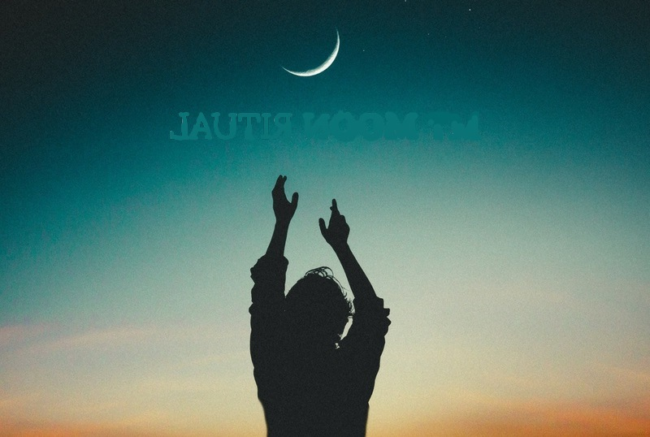

Oh the Moon!
The Moon!
Did any of the commentators place the moon in a position to
receive sacred regard for Yahuah’s month commencement?

Slide 55
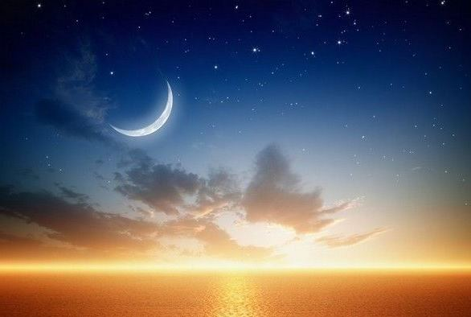

Questions to Ask & Thoughts to Ponder
We’ve travelled through a lot of material.
Where do we go from here?

Slide 56




Concluding the Moon/Month Study
There are still some unanswered questions for this study.
Let’s ponder over some
of them before we discover which ‘no god’ has the
authority … not only
in the Scriptures,
but even with those
desiring to worship
Yahuah - today.

Slide 57
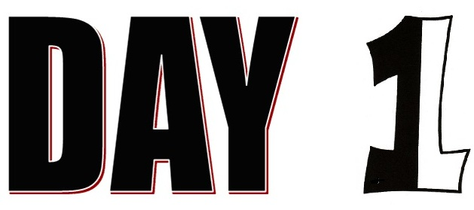

of Creation!
Is the 1st day of creation in the 1st month [Abib/spring] of
i) the FESTAL year,
or is the 1st day of creation in the 7th month [Tishri/fall] of
ii) the CIVIL year?
Would that information affect the following questions?
2. Is the 1st day of creation, also the 1st day of the month
of the 1st year for this earth? (It's not a trick question.)
3. Remember, the "lights" are brought forth on Day 4 of creation week.
R
E
V
I
E
W

Slide 58
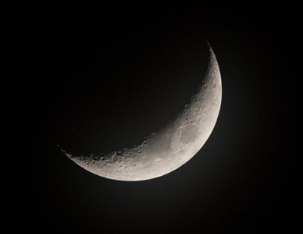
The Moon – Then & Now
4. Today our moon has NO light of its own – only reflected light from the sun. In fact the moon never did have its own light. Consider this verse:
  Jeremiah 31:35 “So says Jehovah,
  who gives the sun for a light by day,
      the laws of the moon,
  and the stars for a light by night,
      who stirs up the sea so that its waves roar,
  Jehovah of Hosts is His name.” LITV – Literal Translation of the Holy Bible
R
E
V
I
E
W

Slide 59
Let’s re-arrange Jeremiah 31:35
“So says Jehovah, who gives the sun for a light by day, and the stars for a light by night,
the laws [ordinances] of the moon, [H3394 yareach]
who stirs up the sea so that its waves roar …”
When the verse is organized this way, it makes sense and aligns with Gen 1:16 perfectly … because
the stars have nothing to do with tides of the sea;
it is the moon that stabilizes the tidal activity.
Also the verse is very clear about the two lights given to the earth:
the sun being the greater light-giver by day; the stars being the lesser light-givers by night. Consider Ps 19:1-9.
R
E
V
I
E
W
Nothing at all can be found in Scripture about the moon being a "light-giver.”

Slide 60
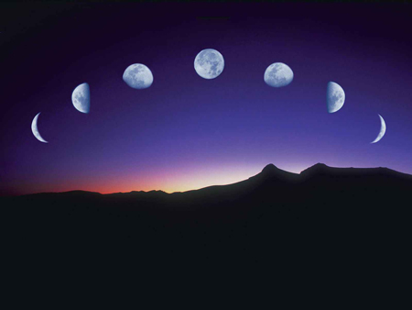

Many “ifs” to Consider
1. The "lights" are not found in the firmament until Day 4 of creation. THEN: was the moon’s phase at conjunction, crescent, or full moon in Gen 1:14-18?
2. Those that believe the festal month was supposed to start with the moon, would that have been on the 1st day of creation, or the 4th day of creation?

Slide 61
Many “ifs” to Consider
3. IF the moon starts the 1st festal month on the 4th day
of creation, what happens to days 1, 2, and 3 of creation?
Are they now dead days?
61

Slide 62

Everyone should know which day of creation is actually the 1st day of the 1st festal month!!
Is the following
thought logical?
“In the first week of creation the moon began
the first festal month on the 4th day.”
How could that be a Torah teaching?

Slide 63
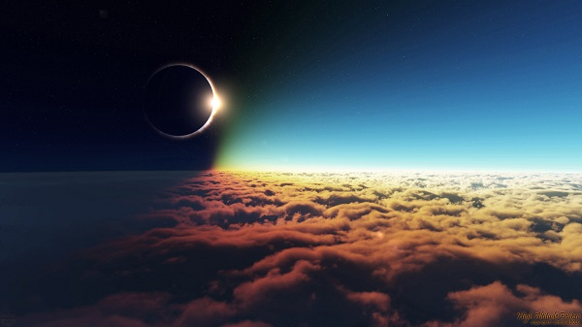
Can Creation Solve the Problem?
Do you think Yahuah's restoration
of the lights in the sky on DAY 4
was deliberate? Why not Day 3?
(Note the meaning of Ps 104:30 … Thou sendest forth thy spirit,
they are created: and thou
renewest the face of the earth.)
The moon/month issue seems to have a huge problem with the creation account.
If the moon is to begin the festal months "today" – then doesn’t the moon have to
follow some kind
of a pattern from
the creation week
in order to begin
the creation festal month as well?
Is it even possible for Day 4 to be the beginning of Yahuah’s first festal month?
If not, then does that mean the moon can never begin Yahuah's festal months?

Slide 64

What About Other Arguments?
Many say the moon was in conjunction for days 1, 2, & 3;
then the crescent appeared on Day 4 of creation.
How could that happen when there were no visible lights
in the firmament until Day 4?
Is it possible that a conjunction would last three full days
on the first week of a perfect creation?

Slide 65
What About Other Arguments? (con’t)
Did the moon even have any phases?
How many people can give confirmation about how
the festal month begins by using only Genesis 1?
Do they know there are 2 types of months beginning in the first week of creation?
Or, do most of them default to Exodus 12 and the idea of a full moon on the 14th day to prove the
1st festal month began with the moon?

Slide 66



It’s The Same Old Argument!
Most say Exodus 12 supports the 14th day as having a
full moon for Passover
in the month of Abib,
so … the 1st day must be
the new moon. HOW?
Where’s the Scriptural
proof for this?

Slide 67

What about this thought?
There’s no need to
look for a full moon at Passover, because the moon has nothing to do with ushering in the
festal months anyway!
67

Slide 68

What about
another thought?
If the Passover of Exodus 12 had a bright
full moon, then why did the people
need the “Pillar of Fire” by night to guide their steps when they left Egypt for the next
three days of travel into the wilderness?

Slide 69

There is a lot of light when travelling at night under the light of a full moon.
Could it be in Exodus 12, the next night of Abib 15 really was also a very dark night because:
1) the moon was not full, or …
2) it was in full conjunction?!
Question: Would Yahuah use
a very dark night to emphasize
His Glory cloud?
… And this thought?

Slide 70


Full Moon on the 14th day of the Month?
?
Where in the Scriptures is there even one witness that the 14th
day of the 1st festal month must be attended with a full moon?
How are these conclusions found in Torah?
Is it possible that what most feast keepers have been taught about the moon is
nothing but a strong pagan traditional belief
handed down from the Rabbis?

Slide 71


How did the Moon receive custody of the Festal Month?
A short review: Moon worship, or sacred regard for the moon, along with sun worship has had a huge impact on Yahuah’s people all through the ages including many Feast Calendars today. Here is a short review of what has been brought forth so far:
In the Garden: The “fallen Lucifer” was given sacred regard in the garden. From the old word “leuk” the name Lucifer connects to the moon through the words “lunar & lunation.” The moon is linked to worship of the moon goddess – especially in the Asherah [garden] groves and “high places.” Today, sacred regard is still being given to the moon through the
moon-month commencement on the feast calendars.
Adam to Noah: The patriarchs themselves remained
relatively free from worship of other gods.
After the Flood: Nimrod became the first sun god;
Semiramis became the first moon goddess.
Terah/Abraham: Called out of Ur of the Chaldees …
an area of pagan sun god and moon goddess worship.
R
E
V
I
E
W

Slide 72

How did the Moon receive custody of the Festal Month?
Haran: Terah resides here … a center dedicated to moon goddess worship.
Terah/Laban: Both were attached to their [teraphim] moon images,
very likely a family business.
Abraham: Yah’s patriarch “called out” from moon worship, to reside in Canaan.
Shechem Oak Tree: Jacob buries the family idols that Rachel stole from her father. These “teraphim” moon images link to Terah.
Egypt: Great multitude of pagan Egyptians (and their gods), leave with Moses.
Mt Sinai: Sacred regard given to the pagan gods including the moon goddess
through the altar and golden calf in this moon worshipping area,
the Wilderness of Sin. Before Moses died he gave strict
instructions in Deut 4 & 17 to NOT look to and/or
worship the [gods of the] sun, moon, stars, etc.
Remember: the moon goddess altar is still standing today.
Jericho: Joshua was commanded to destroy this
moon worshipping city before settling in Canaan.
R
E
V
I
E
W

Slide 73

How did the Moon receive custody of the Festal Month?
Shechem Commitment: Joshua encouraged the people to put away
their family idols of sun and moon gods.
Old Testament history: Ashtoreth moon goddess worship was a
huge problem in the groves and high places for both Israel and Judah.
Hezekiah: Sun dial miracle had a direct affect on moving the moon out
of its 30 day orbit as Yahuah tried to move His people away from the
pagan ways of moon goddess worship.
Return from Babylon: Judah’s exiles incorporated the Babylonian sun and moon components into Yahuah’s calendar. For most: sunset begins the day;
the crescent moon commences the month!
Today: The majority of Feast calendars all honour the
sunset for “day-start,” but even more serious they honour
a variety of moon sightings for month start when nothing is
documented in Scripture for this. The moon component in
these feast calendars gives honour to Lucifer’s moon goddess.
R
E
V
I
E
W

Slide 74

Are Christian Churches Today
Connected to Pagan Worship?
?
Sunday Christians: all honour their day of worship on
“Sunday” – giving homage to the “sun god” from ages past.
Sabbath Keepers: all honour the commencement of
their worship days beginning with the sunset the
night before Sabbath, paying homage to
the “sun god” from ages past.
Sabbath Keepers/most Feast Keepers:
In addition to honouring sunset,
most also honour the moon
for the festal month-start,
thus paying homage to the
“goddess of the moon.”
R
E
V
I
E
W
Which of the 3 groups is
most deceived by Jewish mindset?

Slide 75


More on the Moon Component …
Does the full moon have a connection to the crystal ball?
Who is being worshipped?
The moon
goddess?

Slide 76


Remember “Oh the Moon!” Part 4:
Really … Who is being worshipped?
Lunar –Lunation –Leuk –Lux -Lucifer!

Slide 77


According to the Jews, the moon always begins the festal month!
“And most of the feast keepers wander after the …!”
The moon is part
of their calendar as with the pagans!!

Slide 78

More on the
Sun Component …
Most people know the sun has been worshipped by every pagan nation including every aspect of imperial and Papal Rome to this very day!
Who is actually being worshipped?

Slide 79


Yet, according to the Jews, the sun governs the Sabbath commencement!
“And most of the Sabbath keepers wander after the …!”
The sun is part
of their calendar as with the pagans!!

Slide 80

Yes, the Jews had (& have)
“a Hebrew” (?) calendar.
Jewish
However,
it is NOT
Yahuah’s Hebrew Covenant Calendar!
Their Jewish calendar simply hides the
sun god and moon goddess even today!

Slide 81
It’s time to firmly answer this question:
Do the patterns of history repeat from
the Old Testament up to today?
Which
“no god”
will gain the
authority?
… the sun god?

Slide 82
… or the moon goddess?
Semiramis
Will the Scriptures offer any clues?
82

Slide 83

Abundance of Pagan Worship
For the listed phrases there are at least 887
Old Testament references linking to pagan worship.
# in OT | Phrase | # in OT | Phrase
140 | Image/Images | 80 | High Places (moon worship)
46 | Graven Image(s) | 3 | High Places of Baal
23 | Molten Image(s) | 2 | Priest of Baal
5 | Carved Image(s) | 4 | Sun, moon and host of heaven
2 | Images of Baal | 14 | Host of heaven
95 | Idol(s) | 220 | gods (pagan)
62 | Baal | 6 | no gods
18 | Baalim | 10 | thy gods
5 | Queen of Heaven | 34 | their gods
3 | Ashtoreth (moon goddess) | 52 | Altars
10 | Molech/Moloch/Chuin | 12 | Burnt their children in fire
41 | Grove(s) (moon worship) | 887 | References to pagan worship/practices
R
E
V
I
E
W
Sun gods = 87
Moon gods = 129
Total: 216
OT history books = 549 chapters!
Average mention of apostasy = 15 times in every 10 chapters!
Notes:
Sept 15 Calculation: OT Chapters = 989 …
Number of chapters in Torah (197) + chapters from poetry books [Job, Ps, Prov, Eccl, S of Songs] (243) = 440 chapters
Total OT chapters = 989. Minus 440 chapters = 549 chapters left for the books of history and prophecy.
Number of chapters for only the historical books from Joshua to Malachi = 549
Number of times pagan worship is mentioned in the historical/prophetic books: 549 chapters [divided by] 887 mentions of apostasy = 1.6 times/chapter …
OR: 15 mentions about paganism in every 10 chapters.

Slide 84
Record of 216 ‘no gods’
Old Testament
entries for:
Sun god worship (Baal/Baalim) = 87.
(or 40%)
Moon goddess worship (Ashtoreth; Queen of heaven; high places & groves) = 129!
(or 60%)
It’s time to Expose
the ‘no god’ in authority!
In the Old Testament
the moon goddess
has greater authority
over the sun god!
It’s still the same today!

Slide 85
The Moon has
been Exposed!
Review of ‘no gods’
Old Testament
entries for:
Sun god worship (Baal/Baalim) = 87.
(40%)
Moon goddess worship (Ashtoreth; Queen of heaven; high places & groves) = 129! (60%)
The moon goddess has greater authority
over the sun god!
But is it …
A Lunar Deception?
A Lunatic Authority?!
… or both?!

Slide 86


Walk in the Light
Eph 5:8, 11
For you were once darkness,
but now you are light in Yahuah.
Walk as children
of light;
have no fellowship with the
unfruitful works
of darkness,
but rather
expose them.
NKJV
The moon is a burden from the pagans
with unscriptural endorsement.
Let it go!

Slide 87
These Questions Should
Now Have Answers!
Where did sun and moon worship really begin?
Were the patriarchs between Adam and Noah
responsible for promoting worship of ‘no gods’?
Do the sun god and moon goddess represent the major
“no gods” or are there other more important pagan gods?
If the sighting of the sun and moon are part of the
worship calendar, is that action regarded as worship?
If sacred regard, and/or allegiance of any kind, is given to
the sun and moon for any reason, is this classed as worship?
Did this study conclude which ‘no god’ is more deceptive in the festal calendar? Sun god … or moon goddess?
The Old Testament indicates the moon goddess had much more sway and authority over Yahuah’s people! Surprised?

Slide 88

This question should not have to be asked anymore!

Slide 89



A New Thought for
Covenant Calendar
L
EARN
T O
C
O
U
N
T
Ps 90:12 So teach us to number our days,
that we may apply our hearts unto wisdom.

Slide 90

Arthur Schopenhauer All truth passes through three stages:
Audience
Participation
3rd
It is accepted as being self-evident!
2nd It is violently opposed.
1st It is ridiculed.
What are your thoughts on the “moon goddess”
having priority in most feast calendars?
Did Judah hide their ‘no gods’ in their calendar?

Slide 91

How will you answer
calendar accusers?
The answers are only found in the word of Yahuah!
With a complete Covenant Calendar study each one should be able
to say with King David in Psalm 119:
I understand more than the ancients, because I [study and] keep thy [COVENANT] precepts;
So shall I have wherewith to answer him that reproacheth me: for I trust in thy word.

Slide 92

Psalm 119:
Thy word is a lamp unto my feet,
and a light unto my path.
89 For ever, O Yahuah, thy word is settled in heaven.
Will you join Yahusha and the Great Patriarchs
of Yahuah to restore the Covenant Calendar?

Slide 93


Is it Time to Leave Doubt Behind?
There are many people searching for Yahuah's Covenant Calendar.
The complete moon/month study shows beyond a shadow of any doubt that the moon is not involved with the calculation for the month commencement of Yahuah's annual feasts and festivals.
The moon/month is connected to the agricultural ordinances to
bless this earth and mankind ~ a very important mandate for us.
Satan will use every possible method to derail our sacred regard redirecting it - for the moon - where it does not belong.

Slide 94

Israel and Judah persistently gravitated toward the pagan feasts over Yahuah’s worship statutes. Their allegiance was CONTINUOSLY surrendered to a “created.” (Rom 1:25) Sadly their …
… allegiance was never delivered permanently to THEIR CREATOR!
It was their sacred regard for the moon [goddess] that affected their feast calendar the most - very nearly
separating them from Yahuah completely. (Isa 1:15)
The moon goddess is still given sacred regard today, by having the authority to appoint the moon as the commencement of the Festal month or a weekly Sabbath.
That should be nothing new under the sun!
Definitely, there is no doubt the sunset day-start
is also a very serious matter. BUT …
What about the commencement of the Tequfah in Gen 1?

Slide 95




The Covenant Calendar study is now ready to move forward.
Creation’s First Tequfah Witness for
Covenant Calendar
(Part 1 of 2)
Coming on
Jan 5, 2019!
95

Slide 96

Questions to consider for the next study:
#1
#2
#3
#4
Would this type of format accurately detail ~ eternity?
Join the next study to find out!
Does Yahuah operate on a year format that must be continuously re-calculated, re-adjusted and manipulated according to man's belief systems?
Does this same year format reveal the format established at creation where identities procreated by the seed within itself ~ “produce after like kind”?
Does Yahuah operate on an established year with a set pattern that duplicates automatically from within itself?
The End
96

Slide 97



If you need assistance
with this information,
please send your
questions to
Charlene Fortsch or
Timothy Astleford:
questions@studythecalendar.com
www.studythecalendar.com
97

